Slide 1

Brand Refresh
2020 Minnesota Credit Union Network Marketing Awards

Slide 2

LOGO
BEFORE

Slide 3




LOGO
AFTER

Slide 4
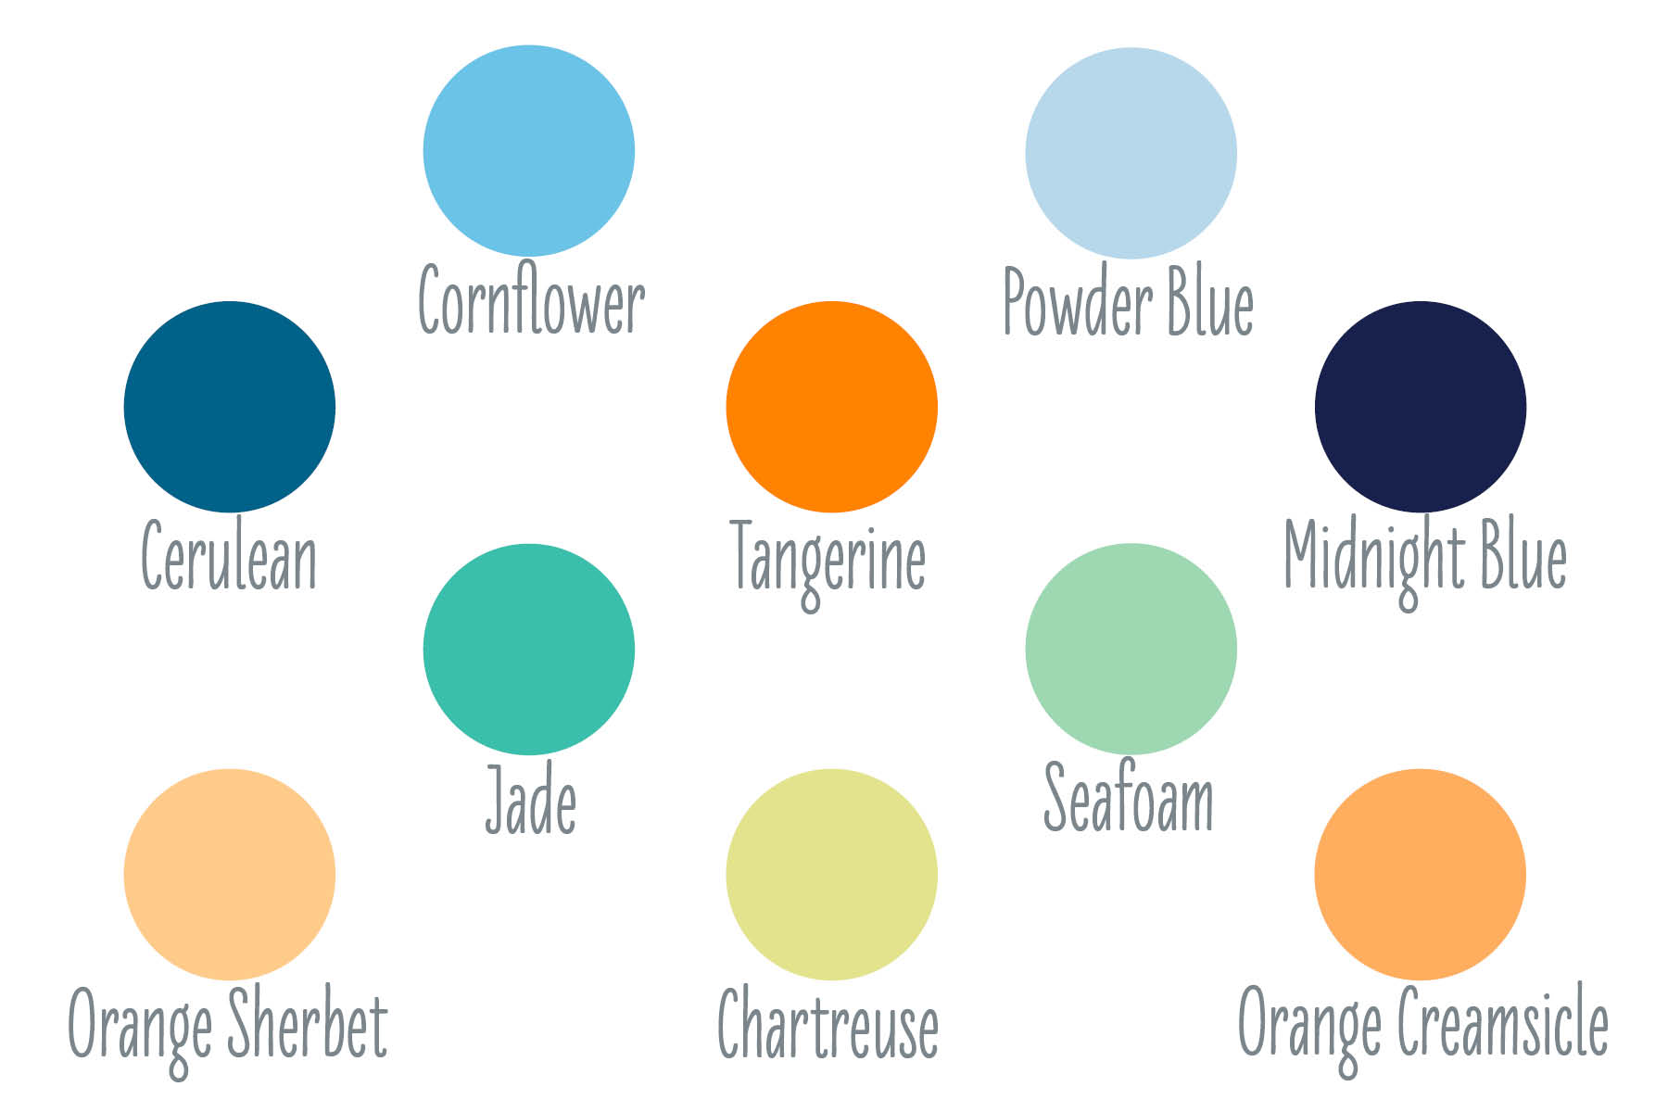
EXPANDED COLOR PALETTE

Slide 5


SIGNAGE
BEFORE

Slide 6
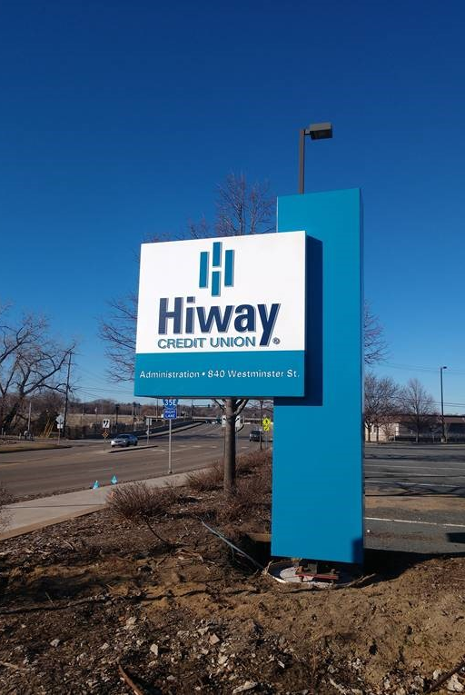
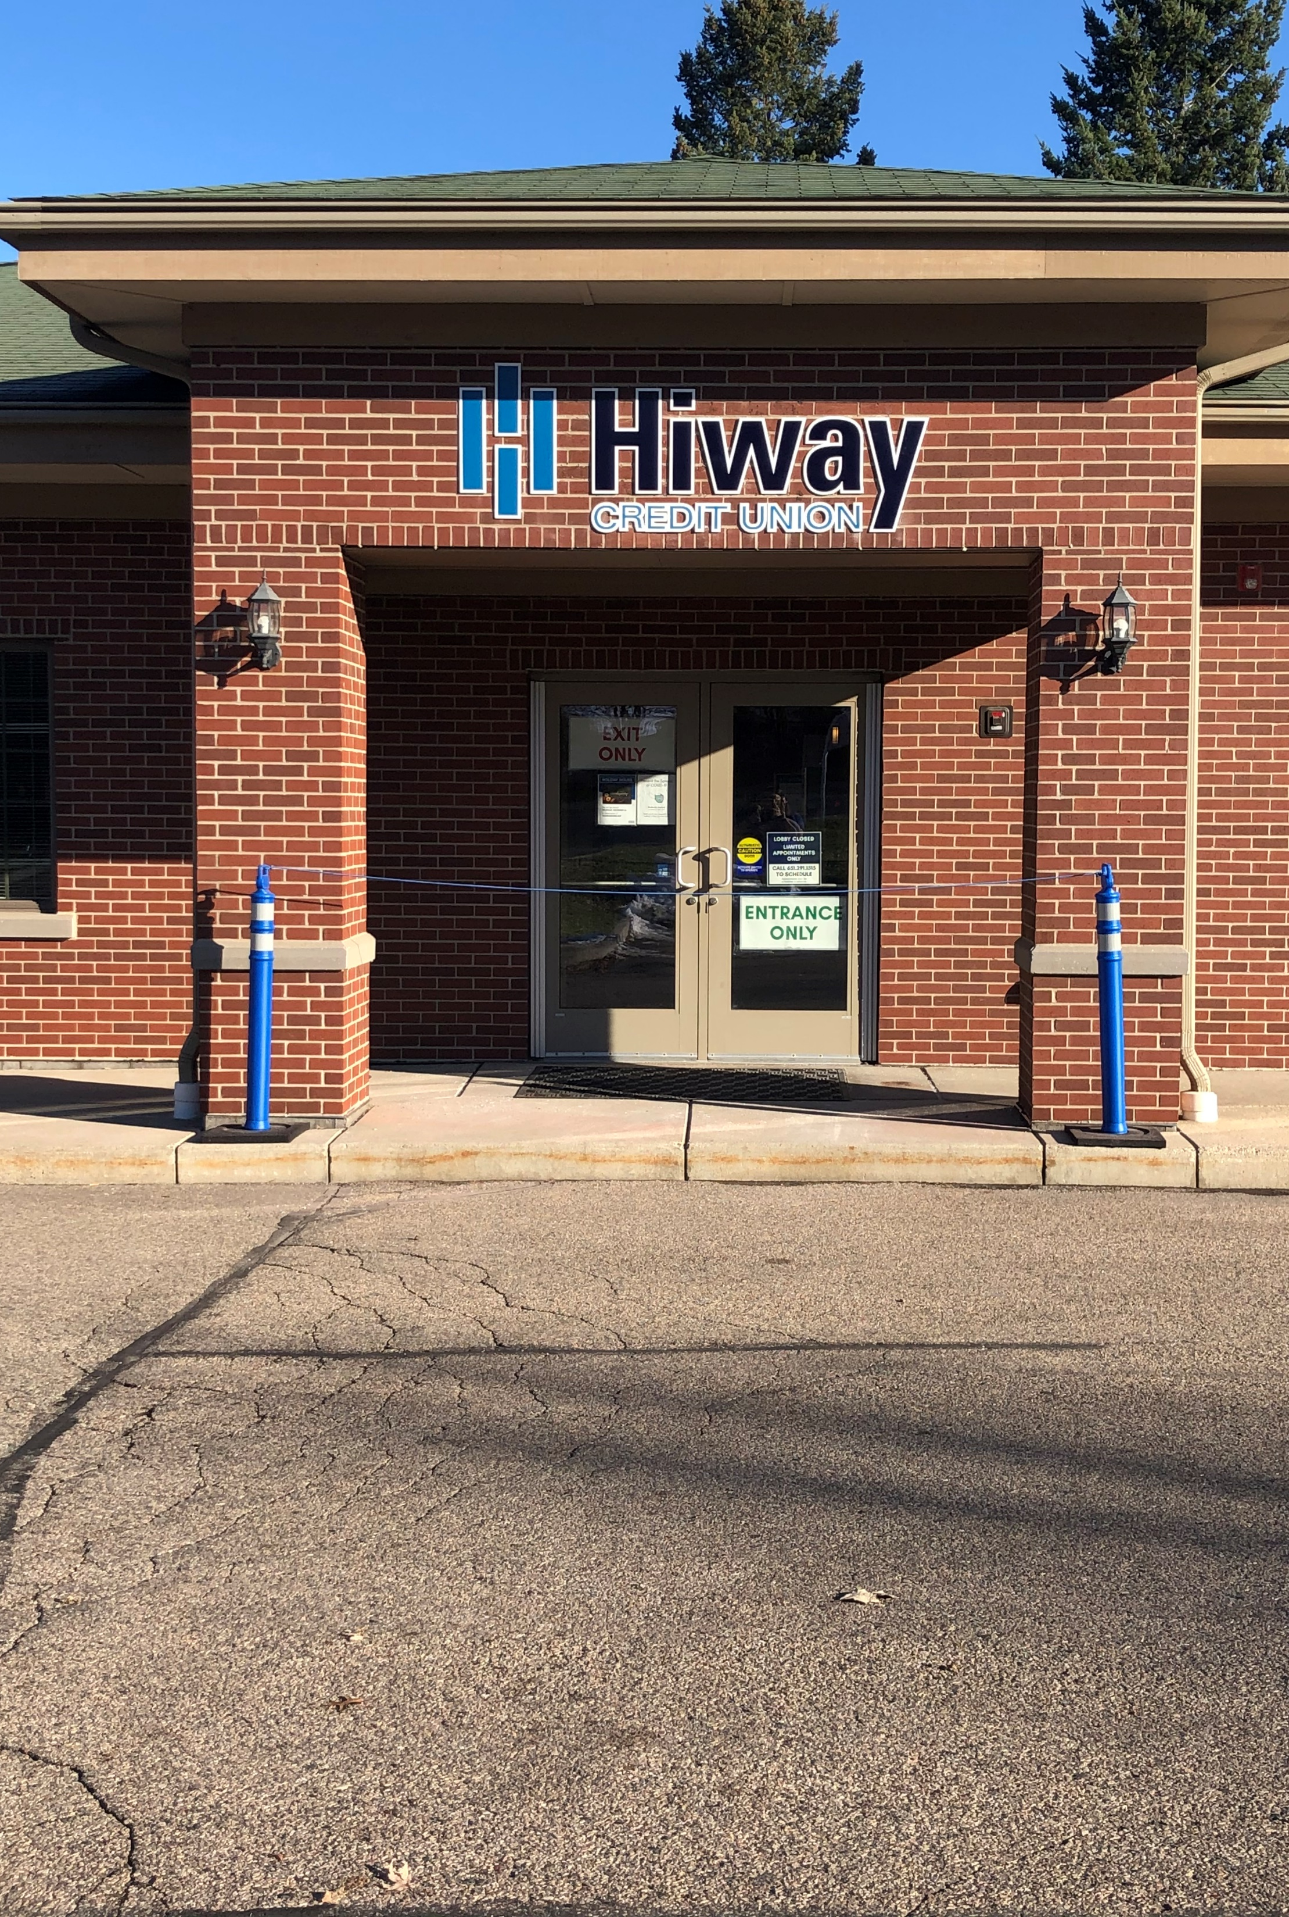
SIGNAGE
AFTER

Slide 7
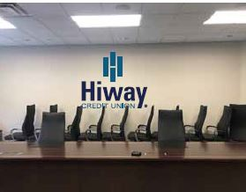
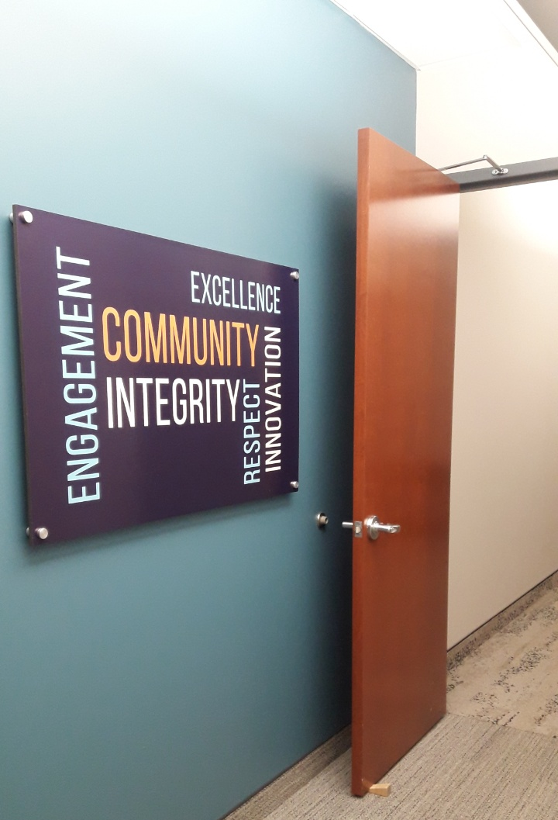
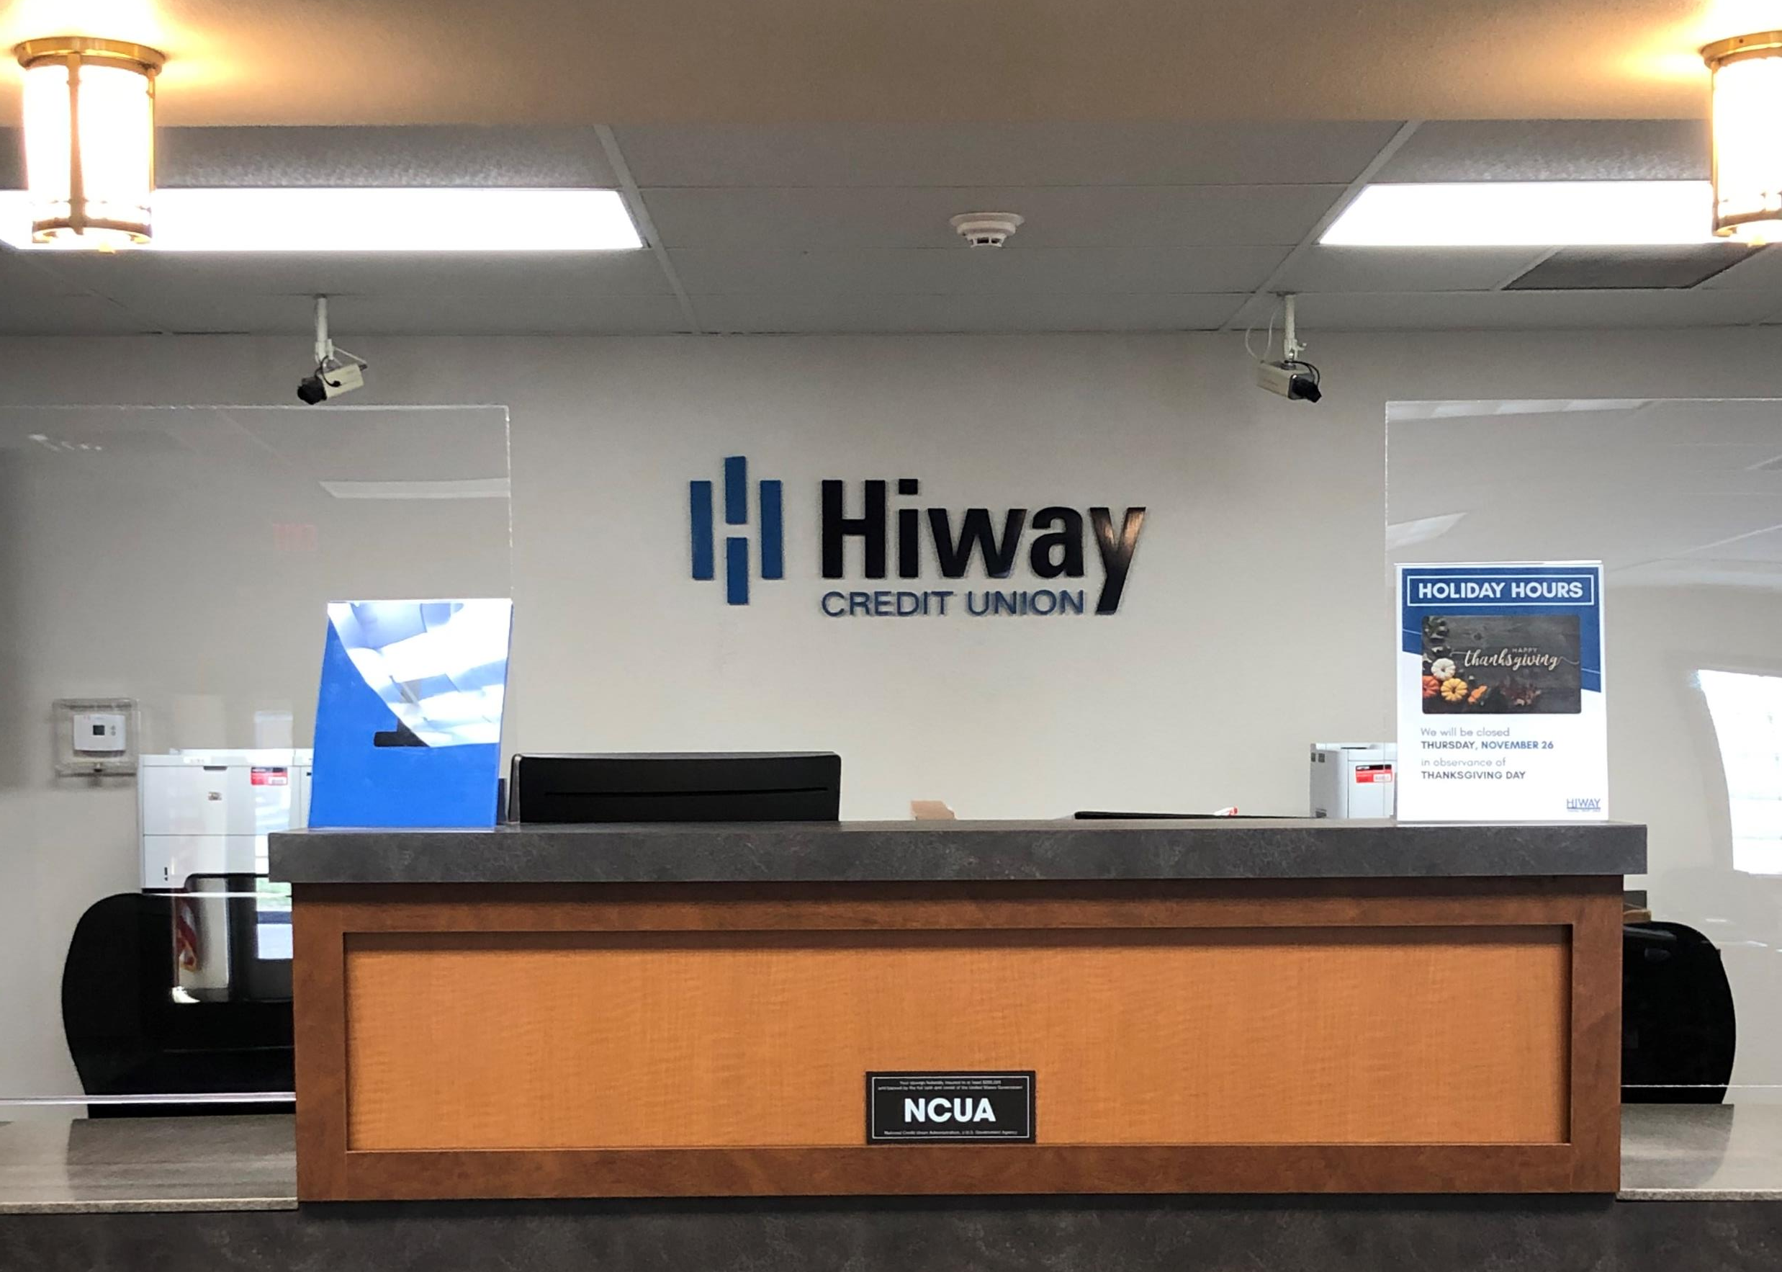
SIGNAGE
INTERIOR

Slide 8
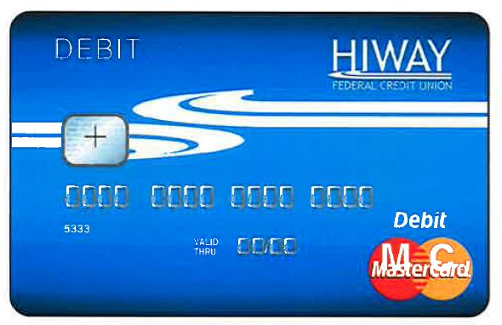
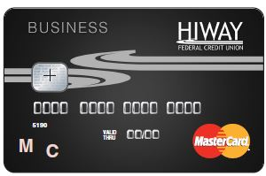
PLASTIC CARD DESIGN
BEFORE

Slide 9

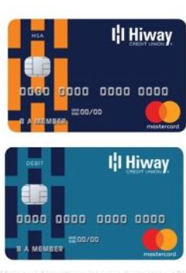

PLASTIC CARD DESIGN
AFTER

Slide 10

COLLATERAL BEFORE

Slide 11


COLLATERAL AFTER

Slide 12
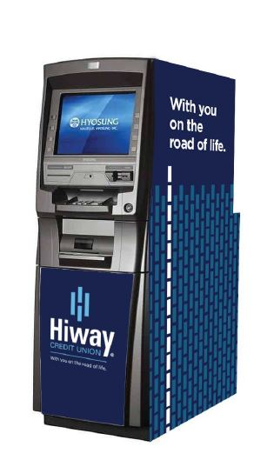
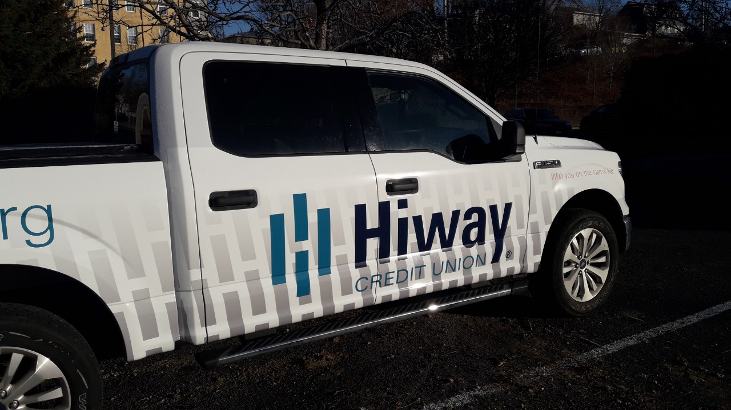
VEHICLE WRAPS & ATMS

Slide 13


MEDIA

Slide 14
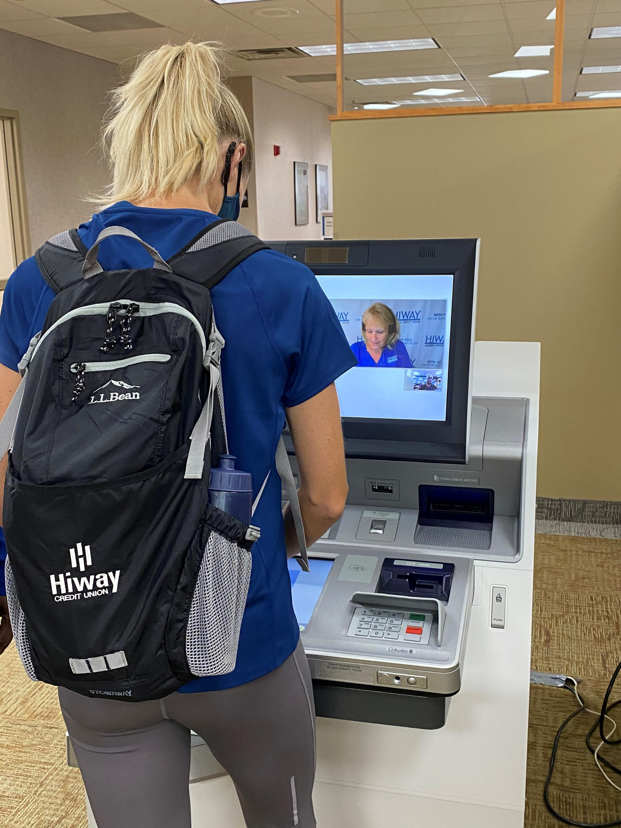
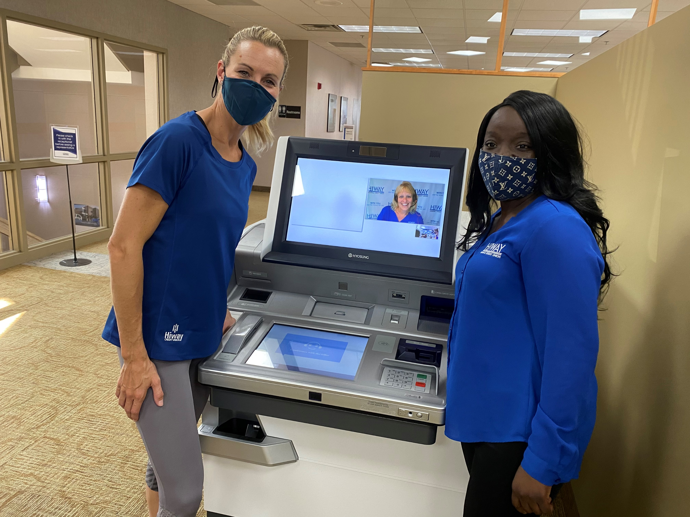
MEDIA
Brand Ambassador Carrie Tollefson

Slide 15
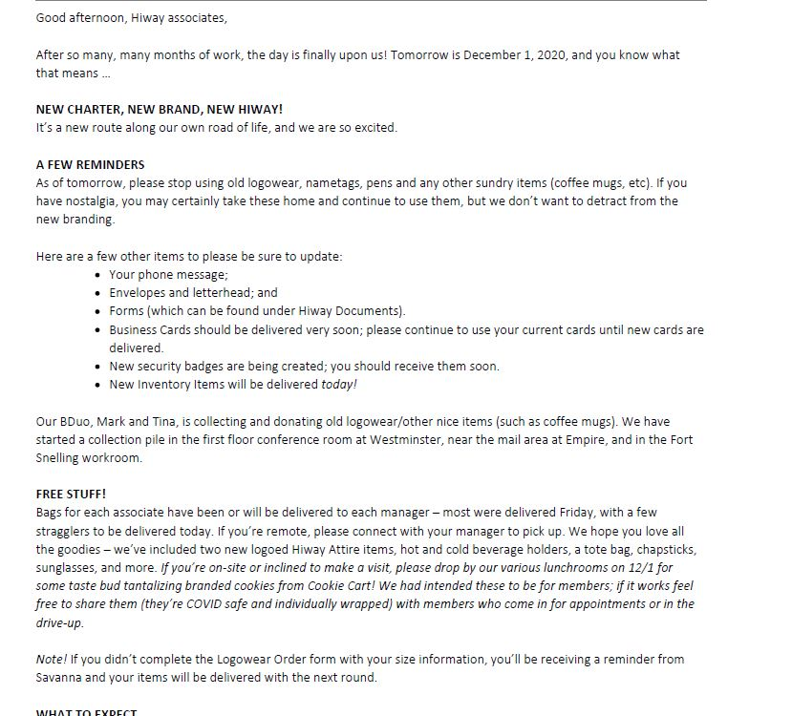
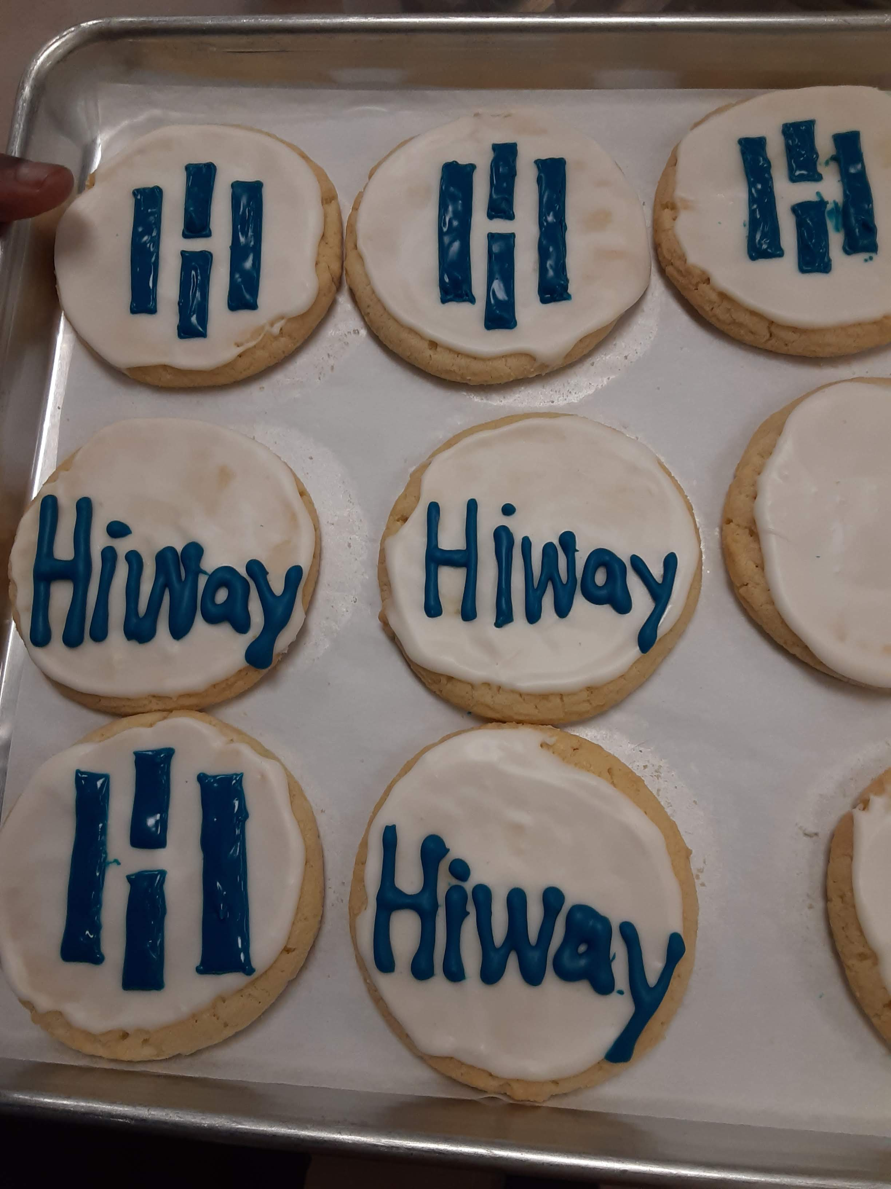


LAUNCH FUN

Slide 16
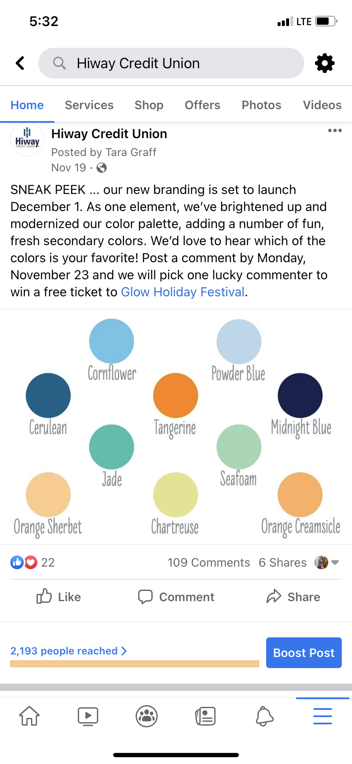
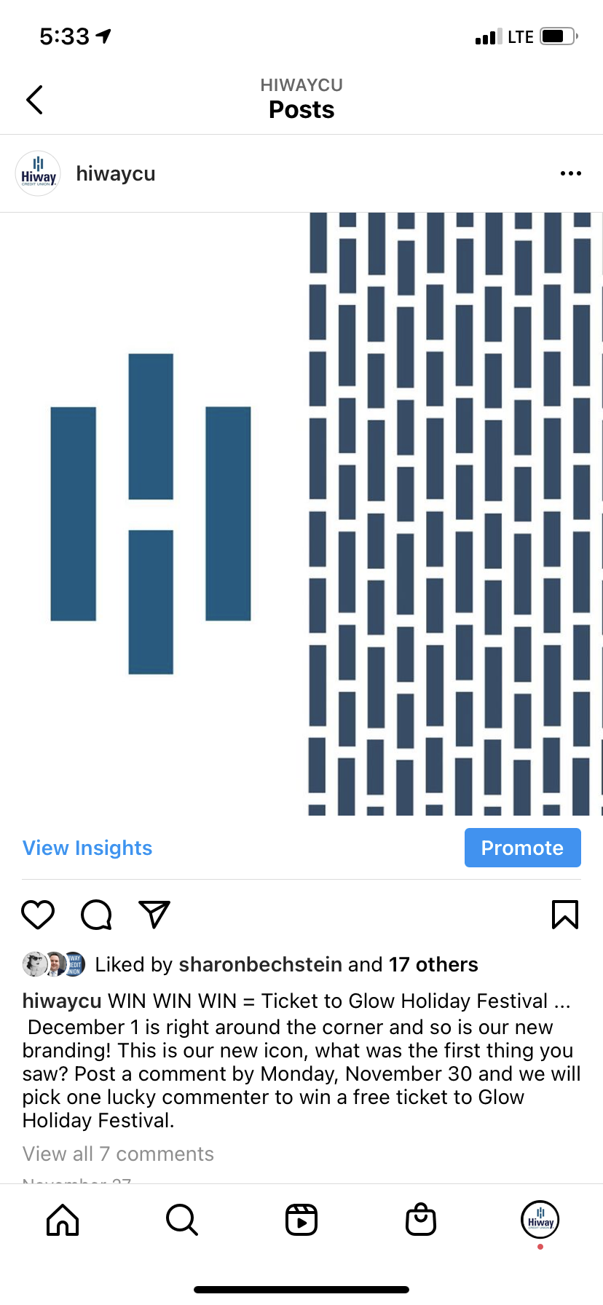
LAUNCH FUN

Slide 17
Thank you!

